Slide 1

“ Risk Prediction In Corporate Financial Management Using IBM Auto Ai Service ”
PRESENTED BY
Team No: CSE_B_01
18UK1A0583 – Koppula Srija
18UK1A05C2 – Vankar Amisha
18UK1A05A9 – Adupa Sowmya
18UK1A05E8 –Kondeti Mukhesh

Slide 2
OUTLINE
INTRODUCTION
OBJECTIVES
SERVICES USED
BUILD MACHINE LEARNING MODEL
BUILD NODE-RED APPLICATION
PREDICTION SHOWCASED ON UI
CONCLUSION

Slide 3
INRODUCTION
A RISK PREDICTION is any measure that is used to predict a person’s risk of an event. Risk Prediction models have become an important part of Decision Making in quick and simple way.
The use of AI in financial risk prediction is still in its nascence, but the combination of an exponential increase in the amount of available data and improving ML algorithms to digest these data has the potential to greatly impact the corporate field especially Banks.
The use of ML in financial risk management can be illustrated through two interesting applications that are developing rapidly: Probability of Default, Early Warning Signals.
This project discusses building a system for creating predictions that can be used in different scenarios. It focuses on predicting fraudulent transactions, which can reduce monetary loss and risk mitigation by building a web application.
Using IBM Auto AI , we automate all of the tasks involved in building predictive models for different requirements from the dataset and predict the results.

Slide 4
OBJECTIVES
Knowledge to work with Watson Studio to create a project
Knowledge to use Auto AI experiment to create a model
Deploying the ML model as a Web Server
Auto Analysis of project
Building an ease of User Interface (UI) to showcase the prediction

Slide 5
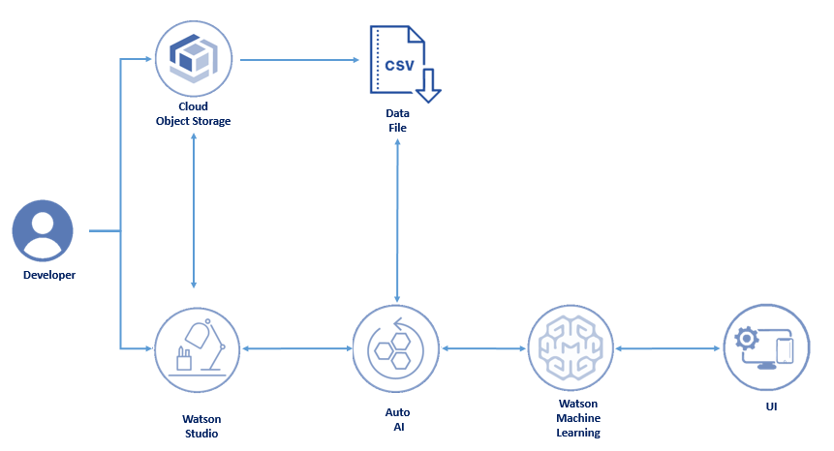
SERVICES USED:
IBM Watson Studio
IBM Watson Machine Learning
IBM Cloud Object Storage
IBM Auto AI
IBM Node-Red

Slide 6
BUILD MACHINE LEARNING MODEL
In this activity we will save a pipeline as a Watson Machine Learning model, deploy the model and score it to view a prediction. Model Building includes the following:
Collect the data set
Create Watson Studio project
Add Auto AI experiment
Run AI Experiment
Save the model
Deploy the model

Slide 7
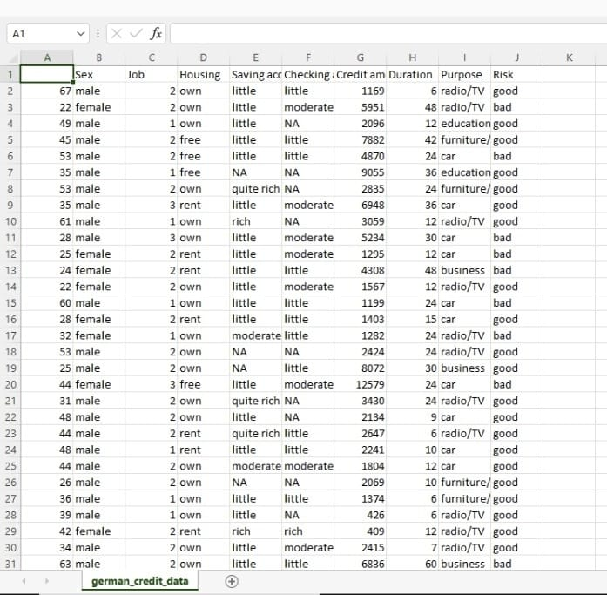
I. COLLECT THE DATA SET
Data set was imported from kaggle
Our “ german_credit_dataset ” contains
1000 rows and 10 columns
Age
Sex
Job
Housing
Saving account
Checking account
Credit amount
Duration
Purpose
Risk (Prediction)

Slide 8
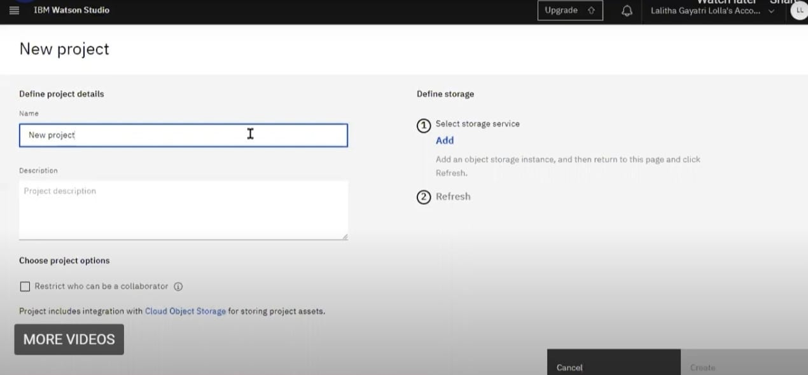
II. CREATE WATSON STUDIO PROJECT
Open Watson Studio Dashboard
Click on Projects (New)
Select empty Project
Define a Project name
Add Description
Click on Create

Slide 9
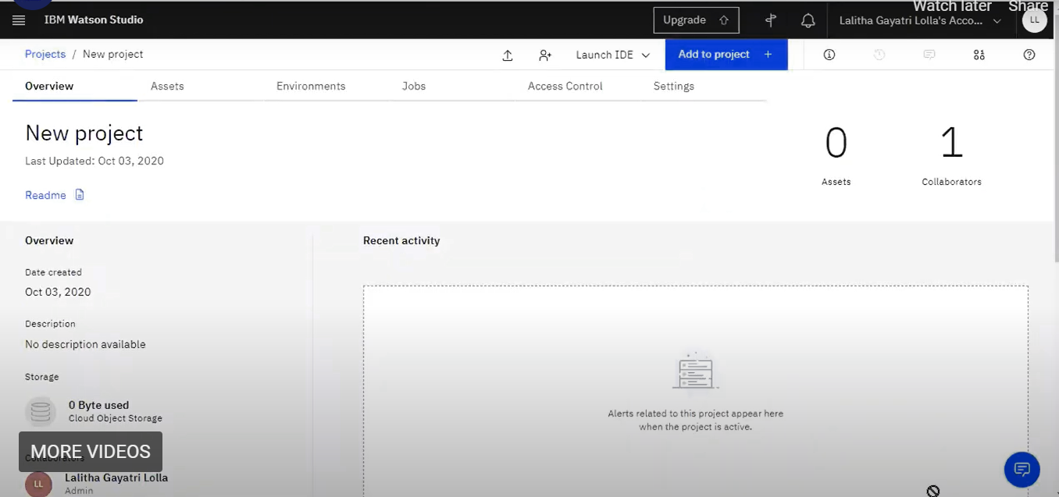
In order to store our data set, we must create Cloud Object Storage Service
Select Storage Service and Click on Add
Configure Service name
Click on Create
Refresh the previous page
Hence the Cloud Object Storage Service is
associated with the project
Finally, it directs to the project page

Slide 10
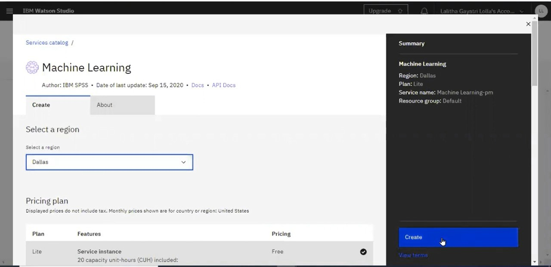
III. ADD AUTO AI EXPERIMENT
The Auto AI graphical tool in Watson Studio automatically analyzes our data and generates candidate model pipelines customized for our predictive modeling problem. These model pipelines are created iteratively as Auto AI analyzes our dataset and discovers data transformations, algorithms, and parameter settings that work best for our problem setting. Results are displayed on a leaderboard, showing the automatically generated model pipelines ranked according to your problem optimization objective.
To add the project
Click on Add Project from Watson Studio project
Select Auto AI
Specify a name and description for your experiment
Select a machine learning service instance and click Create

Slide 11
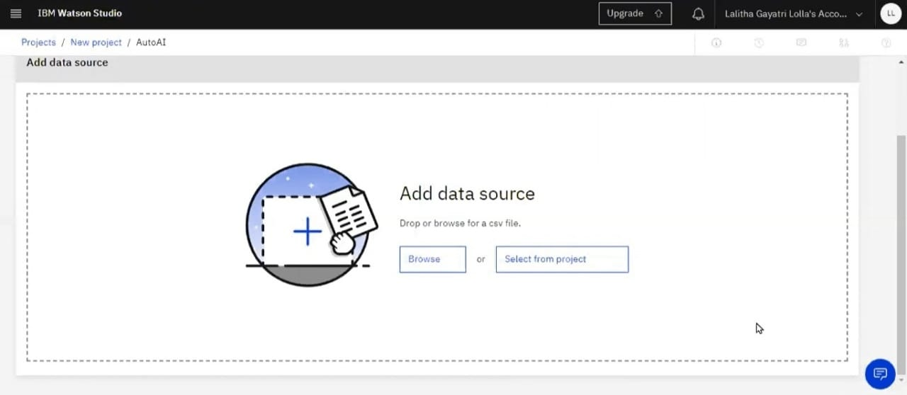
IV. RUN AUTO AI EXPERIMENT
To run the Auto AI experiment, we should upload the dataset. Click on Browse as shown in below fig. Select the dataset (“ german_credit_dataset ” ). Hence it was loaded.

Slide 12
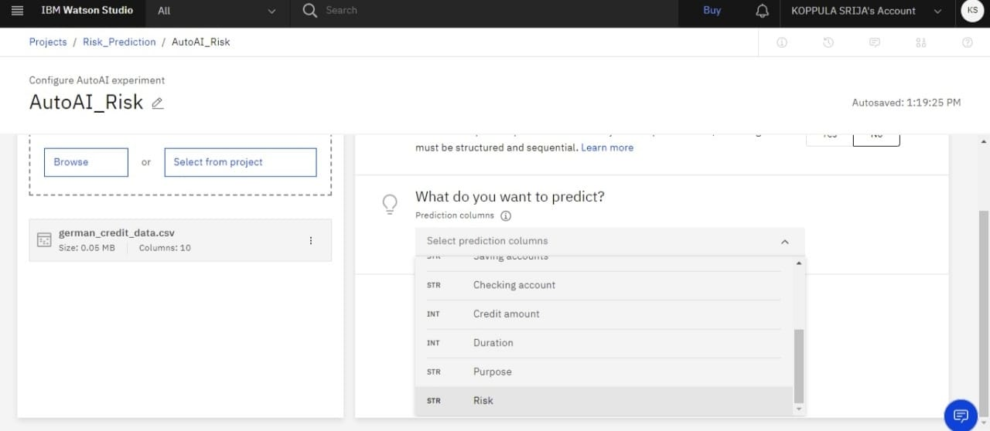
a
From the dropdown, select “risk” as prediction , as it is the output of the model

Slide 13
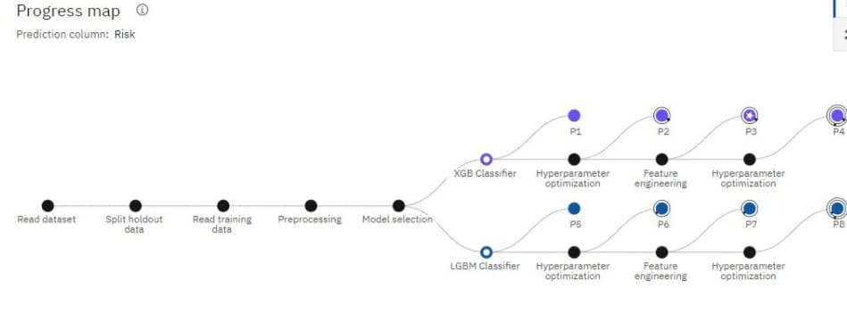
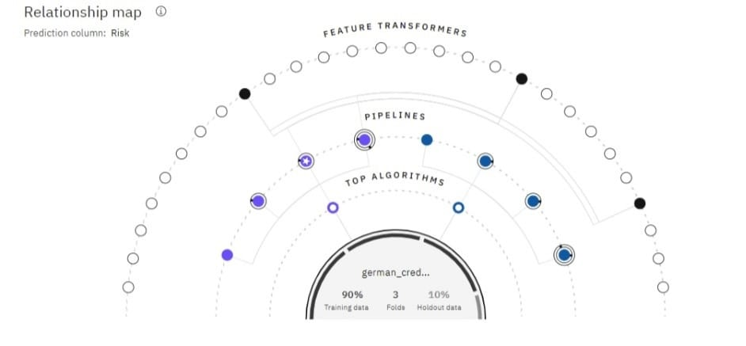
As the model trained from the algorithms, infographic view of pipelines are shown below:
v

Slide 14
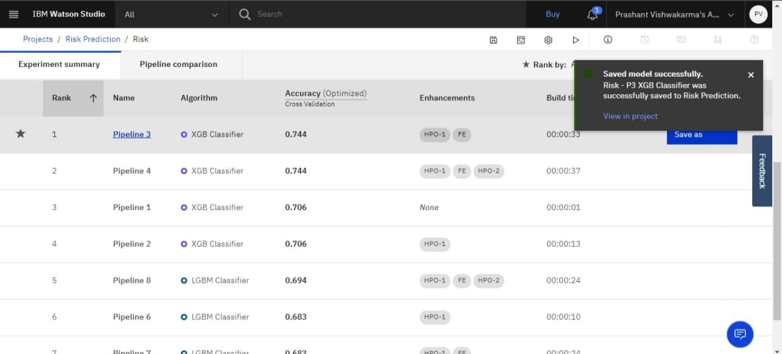
V. SAVE THE MODEL
Once the pipeline creation is complete, we can view and compare the ranked pipelines in a leader board.
Choose Save model from the action menu for the pipeline with the highest accuracy or low error rate (pipeline3: Accuracy- 0.744, Algorithm- XGB Classifier).
This saves the pipeline as a Machine Learning asset in our project. A notification gives you the link to view the saved model in your project.

Slide 15
VI. DEPLOY THE MODEL
Before we can use our trained model to make predictions on new data, we must deploy the model. Now we can deploy the model from the model details page.
Click on the model name in the notification displayed when you save the model
Open the Assets page for the project containing the model and click the model name in the Machine Learning Model selection
From the model details page:
Click the promote to deployment space
Choose an existing deployment space or Create new one
Click add Deployment
In the page that opens, fill in the fields:
Specify a name for the deployment
Select Web Service as the deployment type then Click Save

Slide 16
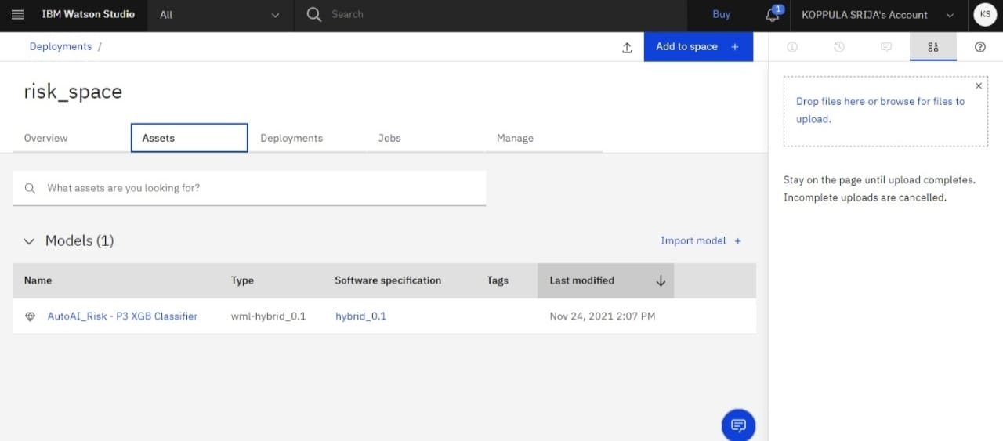
Hence the deployment space is created and shown below in Assets

Slide 17
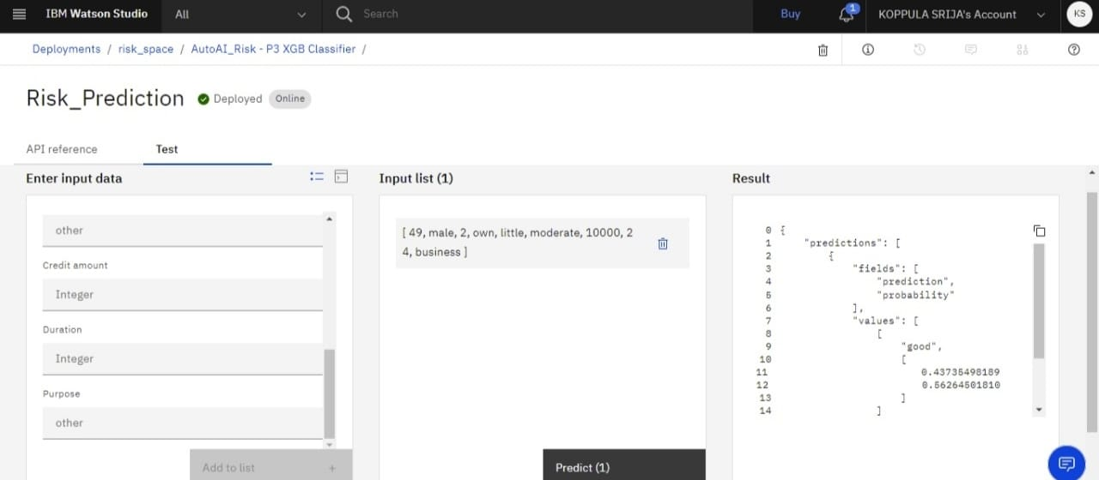
After you save the deployment, click on the deployment name to view the deployment details page. Enter the input values to test and results obtained as predictions.

Slide 18
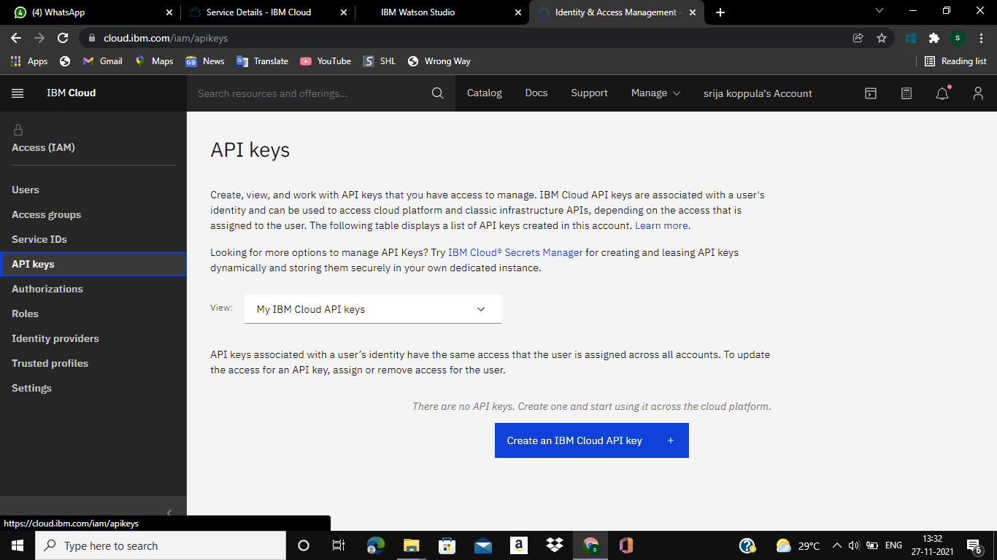
BUILD NODE-RED APPLICATION
Get IAM access token and set a API key

Slide 19
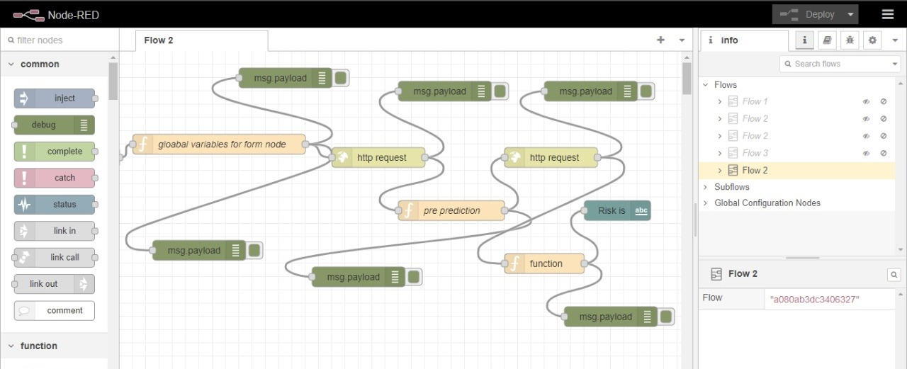
Steps to follow in Node-Red
Create Node-Red service from the cloud foundry of IBM Cloud and deploy the app
Create a UI
Set Global Variables to the UI
Get the access token with the help of http request node
Send the input values to scoring endpoint in json format along with the access token using http request node
Get the Prediction
Parse the output
Showcase the output on the UI

Slide 20
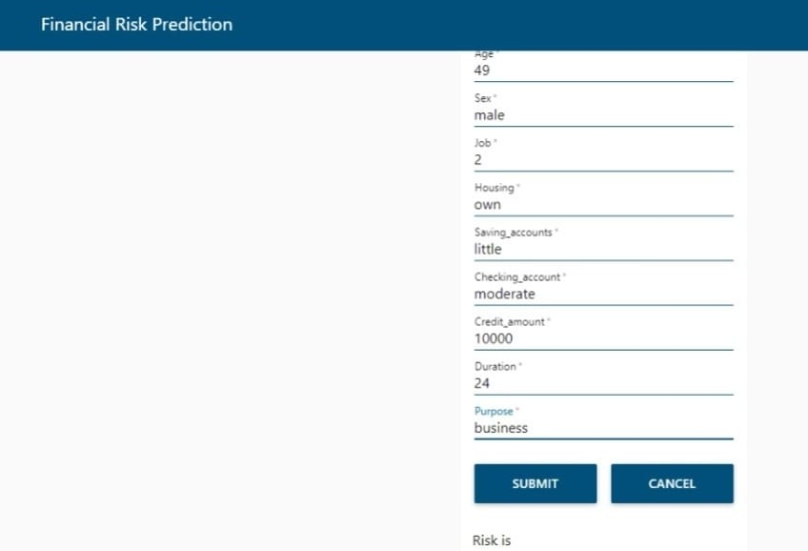
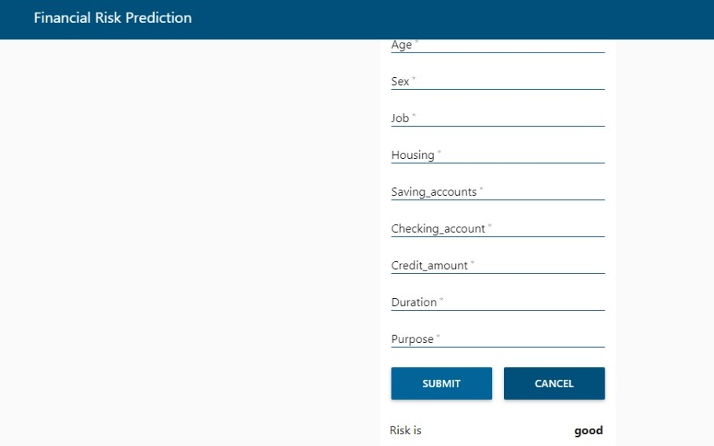
PREDICTION SHOWCASED ON UI
.

Slide 21
CONCLUSION
Banks hold huge volumes of customer behaviour related data from which they are unable to arrive at judgement if an applicant can be defaulter for assessing credit or not. Previously, it is used to be done by manual processes using balance sheets and spread sheets. This type of manual approach could not able to provide desired exact accuracy and it is quiet leanly process
To overcome the drawbacks of manual decision making on assessment of credit, we have proposed Auto AI based Predictions. The predictions are based on efficient Machine Learning algorithm XGB Classifier
This system can able to provide more than 75% accuracy in the predictions of assessment of credit. Hence the model reduces fraudulent transactions which can reduce monetary loss and risk mitigation by building a Web Application

Slide 22
999
THANK YOU

